Slide 1



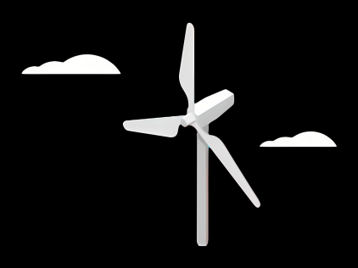
Rotor Hub And Pitch System
Group Members :
Dhruvin Kakdiya
Adharsh Pappinisseri Veedu
Muthu Thirunavukarasu
Syed Mohammed Sikandar
Week number : 01
Date: 23/09/2025
Supervisor: Prof. Peter Quell

Slide 2
Objectives
Design of the Hub
Selection of Pitch system
Design of a pitch system
Design of spinner
Design of pitch-bearing

Slide 3
Rotor Hub
The rotor hub is defined as the component that hosts the blades of a wind turbine, coupling them to the slow-speed shaft, and is designed to withstand the forces and moments exerted by the blades while allowing for independent control of their angle of attack.
The rotor hub is the component that usually holds the blades and connects them to the main shaft of the wind machine.
It is a key component not only because it holds the blades in their proper position for maximum aerodynamic efficiency, it also rotates to drive the generator.
Hubs come in many different shapes and configurations, mostly dependent on the type of generator used and the design of the rotor blades.
Now a days Hubs are generally covered by Spinner.

Slide 4
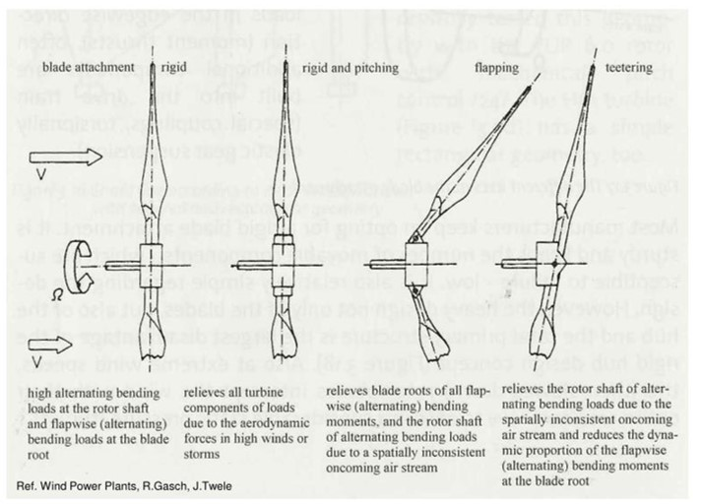
Types of Hub
Rigid hubs (All major parts in a fixed position relative to main shaft)
Teetering hubs (Used for two-bladed turbine and also reduce loads due to aerodynamic imbalances or loads due to dynamic effects from rotation of the rotor or yawing of the turbine)
Hubs for Hinged blades (It’s in some ways a cross between a rigid hub and a teetering hub. It is basically a rigid hub with ‘hinges’ for the blades)

Slide 5
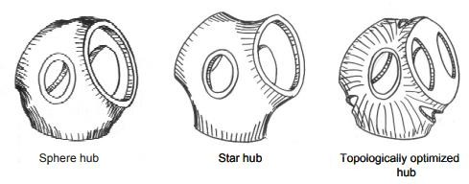
Shapes of Hub

Slide 6
Design criteria
Hub radius (distance between axis of rotation and blade flange)
Connection to shaft (flange or locking ring)
Possibility to adjust pitch angle (slotted holes, marks and scale, locating pins)
Need of internal space to accommodate pitch control mechanism.
Accessibility of bolt heads (from inside the hub, or external flange).
Weight
Cost
Ease of manufacturing and assembly

Slide 7
Manufacturing way of the Hub
There are various manufacturing processes for a rigid hub with pitch including:
Welding
Forging
Casting
For smaller turbines, all three manufacturing methods are used.
For prototypes occasionally using welded fixes.
For multi-megawatt turbines, cast hubs are often utilized.

Slide 8
Pitch System
What is pitch control system in wind turbine?
-Pitch control is the technology used to operate and control the angle of the blades in a wind turbine.
-The pitch system is a closed loop drive system. The turbine main controller calculates the required pitch angle from a set of conditions, such as wind speed, generator speed and power production.
-A wind turbine's pitch control system adjusts the angle of the rotor blades to regulate power generation and ensure the turbine's safety

Slide 9
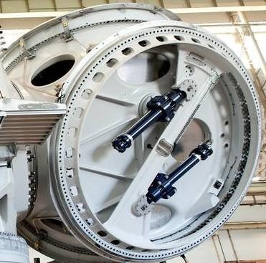
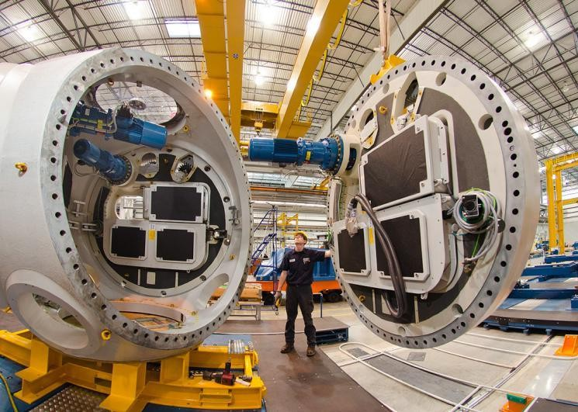
Types of Pitch Control System
Hydraulic Pitch Control System
Electric Pitch Control System
-Internal gear
-External gear

